Slide 1
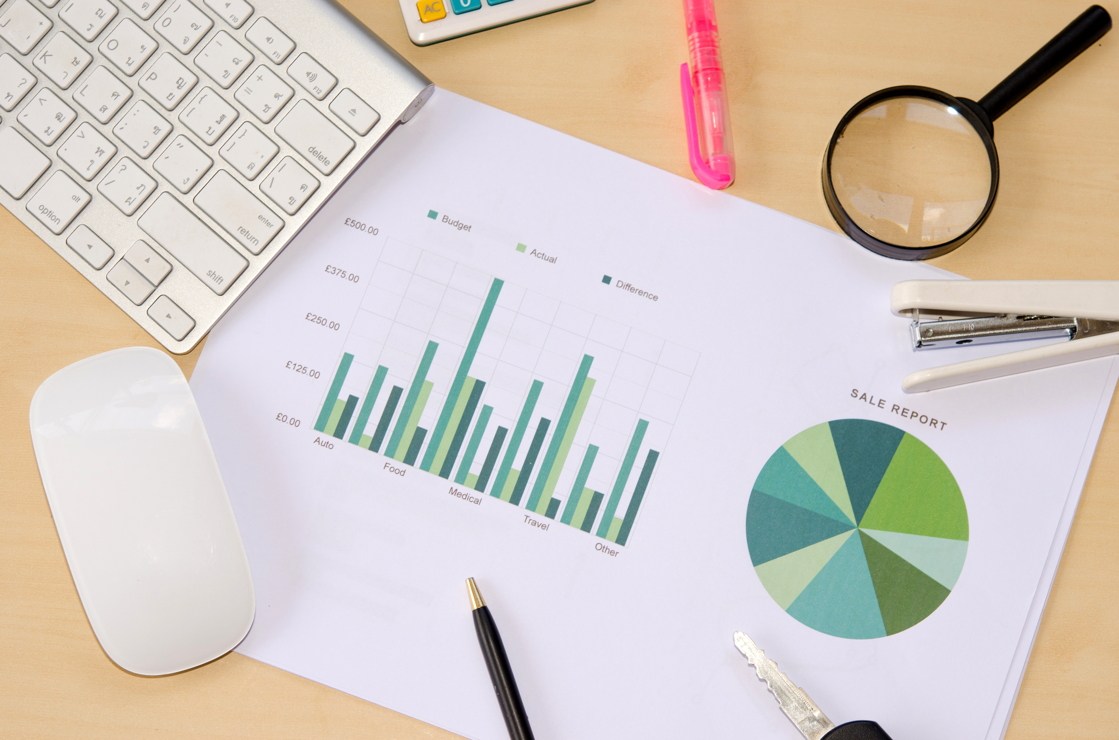



DATA ANALYTICS

Slide 2


CONTENT
01
02
03
04
Introduction
Plan
Prepare
Process
05
06
07
08
Analyse
Visualization
Strategize
Examples

Slide 3



INTRODUCTION
Data Analytics:- It is the science of analyzing raw data to make conclusions about the information. It involves the process of inspecting; cleaning; transforming and modelling data with the goal of discovering useful information; informing conclusions and supporting decision making
For example in retail industry, data analytics is crucial for gaining insights into customer behaviour; optimising operations and driving strategic decisions. Retailers collect vast amount of data from various sources such as sales; transaction; customer interactions and online activities. By applying data analytics they can turn this data into actionable insights to improve customer satisfaction; increases sale and enhance operational efficiency

Slide 4
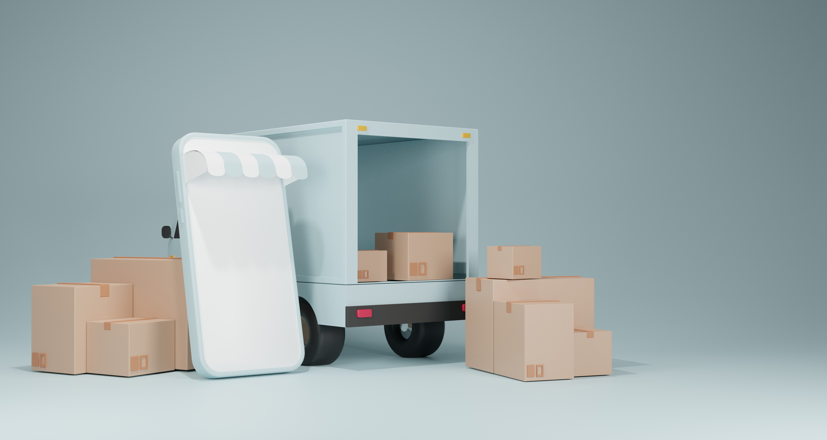

PLAN
The primary objective of this data analytics project is to understand customer purchasing behaviour by gaining deeper insights into how customer interact with products retailers can optimise their sales and marketing strategies. This understanding helps in creating personalised experience; improve product offering and ultimately increasing customer satisfaction on loyalty.
When are the peak shopping times?
What products are most popular?
What customer segments are most valuable?
Knowing the peak times of shopping helps in staffing decisions; planning promotions and ensuring stock availability. Retailers can optimise store hours and enhance customer service during high traffic.
Data needed: Website analytics; Timestamped transaction data for traffic data.
Identifying the best-selling products allows retailers to manage inventory better; focus marketing efforts on high demand items and understand trends. Popular products can be featured in promotions and inventory can be adjusted to meet demand.
Data needed: Sales data from point of sale (POS) systems; Online transactions and Customer feedback.
Segmenting customers based on value allows for targeted marketing and personalised experience. Retailers can identify high value customers and focus on retaining them through loyalty programmes and special offers.
Data needed: Customer demographics; Purchase history; Loyalty program; Data engagement metrics from social media and marketing campaigns.

Slide 5



PREPARE
01
Data Collection is the first crucial step in the data preparation phase. This involves gathering data from various sources to ensure a comprehensive data set for analysis. The key types of data collected in the context include transactional data; customer demographics; browsing history.
02
Data Cleaning is the process of preparing raw data sets for analysis by removing inaccuracies and inconsistencies. This step is crucial to ensure that the data is accurate; complete and reliable. Key tasks involved in data cleaning includes handle missing values; remove duplicates and correct errors.
03
Effective data preparation through meticulous data collection and cleaning is essential for high quality analysis. By ensuring that the data is comprehensive,accurate and consist, Retailers can drive meaningful insights and make informed decisions that derive business success.

Slide 6
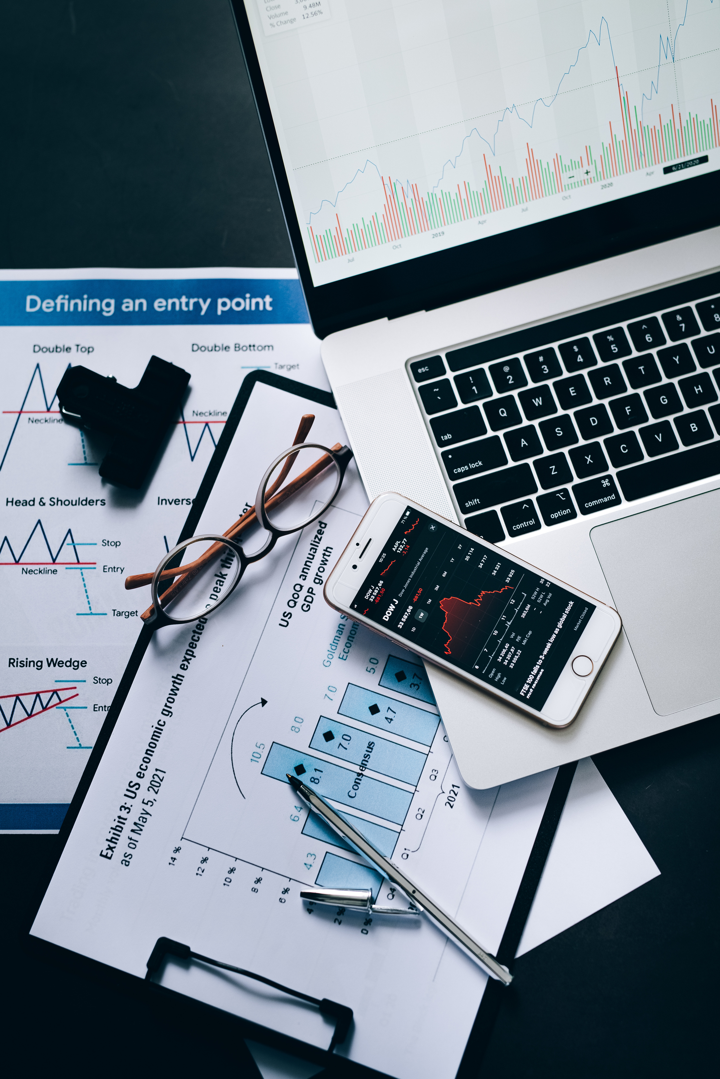
PROCESS
Data Integration and Transformation are critical steps in data analytics process. By combining data from various sources and transforming it into a consistent and analyzable format, retailers can ensure that their analyses are comprehensive and accurate. This leads to more reliable insights and better informed decision making, ultimately driven business success.
DATA INTEGRATION
Data Integration involves combining data from various sources and into a single, unified set. This step is crucial for creating a comprehensive view of all more effective analysis. The key task involved in data integration includes combining data from different sources and challenges such as data quality.
DATA TRANSFORMATION
Data Transformation involves converting data into suitable format for analysis. This step ensures that data is consistent, comparable and ready for the next stages of analytics process. Key task includes formation of standardised formats and aggregate data by time or customer segments.

Slide 7







MODELLING
The analytics phase encompasses EDA and modelling, is where the raw data is transformed into meaningful insights. EDA helps in understanding the data and identifying preliminary patterns, while modelling provides deeper insights and productive capabilities. These analyses enable retailers to make data driven decisions; improve marketing strategies; enhance customer satisfaction and ultimately drive business growth.
EXPLORATORY DATA ANALYTICS
It involves applying statistical; machine learning or computational models to the data to make predictions or discover deeper insights. The following ways perform modelling:
Clustering Algorithm to Segment Customers: K-means clustering, Hierarchical clustering.
Use Association Rule Mining to Discover Product Affinities: it consist of few methods such as Eclat Algorithm, FP-growth Algorithm and Apriori Algorithm.
EDA is a critical step in the data analytics process where analysts use various techniques to summarise and visualise the data. The main goal of EDA is to discover patterns; spot anomalies; test hypothesis and check assumptions. This can be done in following ways:
Summarise data with descriptive statistics
Visualise data to identify patterns and trends.

Slide 8
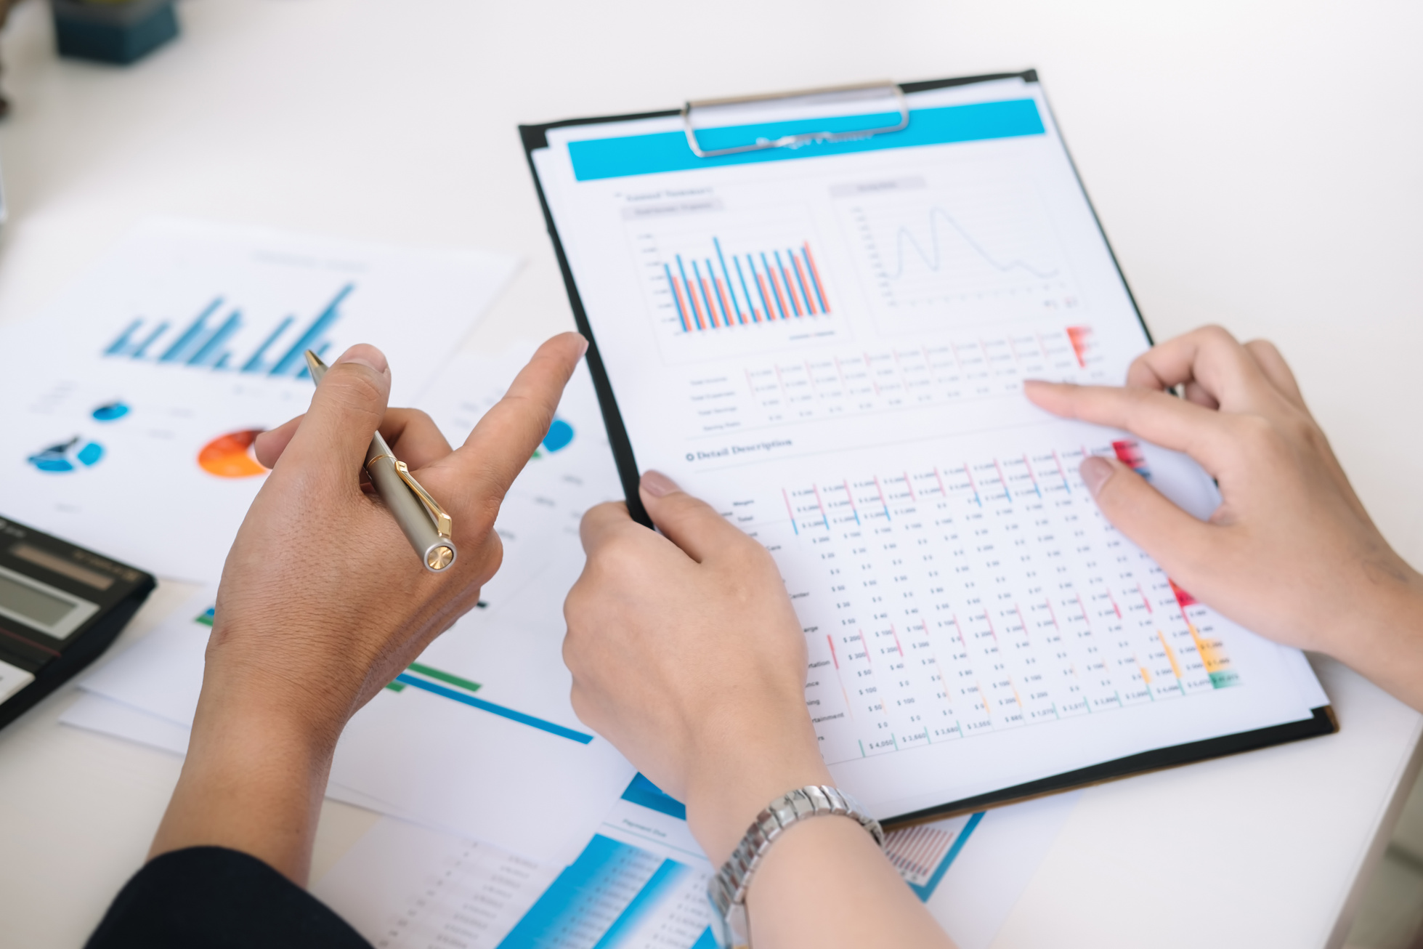

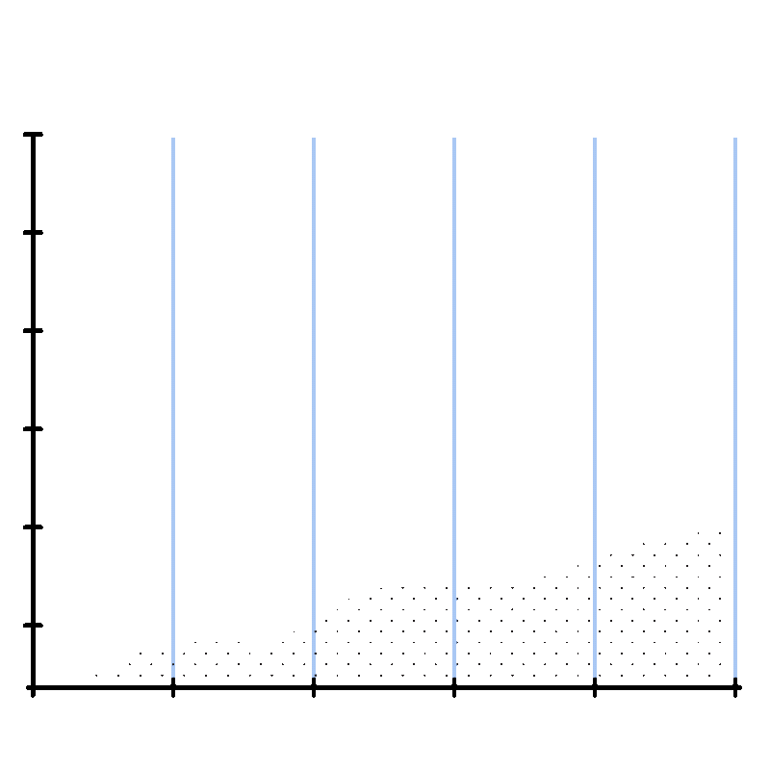
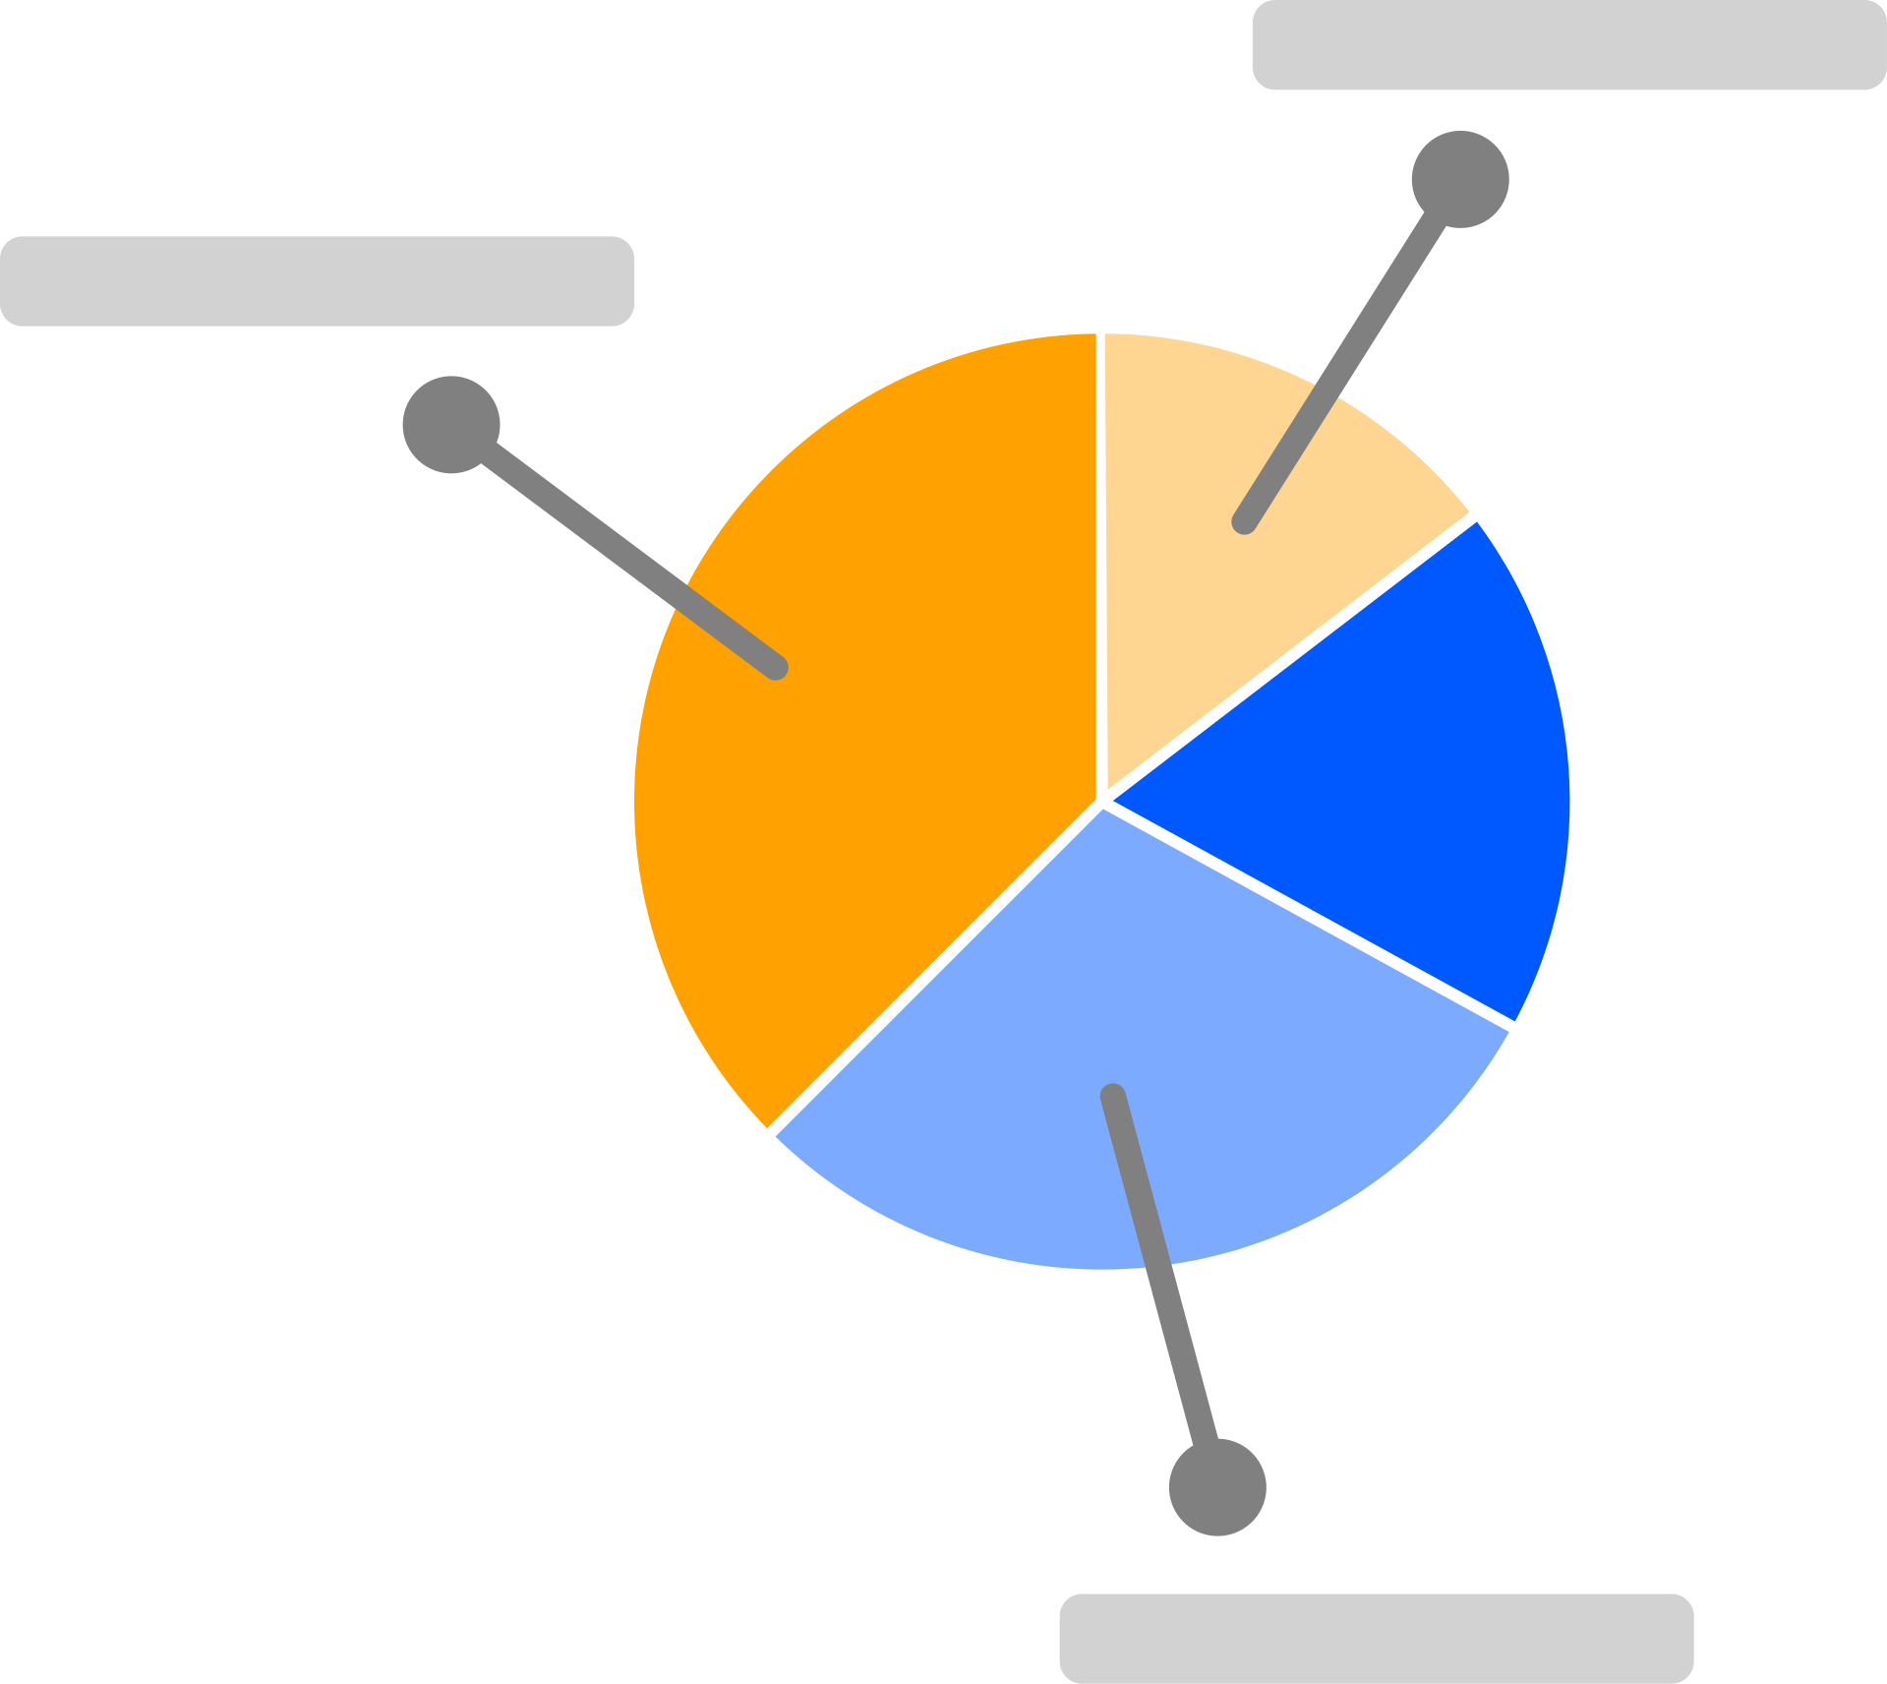
VISUALIZATION
Data visualisation involves the graphical representation of information and data. By using visual elements like charts graphs and maps, data visualisation tools provide an accessible way to see and understand trends, outliners and patterns in data. Creating dashboards is a very recommendable way to visulize the data.
Dashboards provide a dynamic, real time view of key metrics, making it easy for decision makers to monitor performance and identify trends. Detailed reports, on the other hand, offer comprehensive insights on actionable recommendations providing a deeper understanding of the data and supporting strategic decisions. By sharing insights effectively retailers can ensure that the strategies are informed by data, leading to better business outcomes.
Reporting involves compiling the insights derived from data analysis into structured documents or presentations that can be shared with decision makers. It can be done by preparig reports with key findings and recommendations.

Slide 9
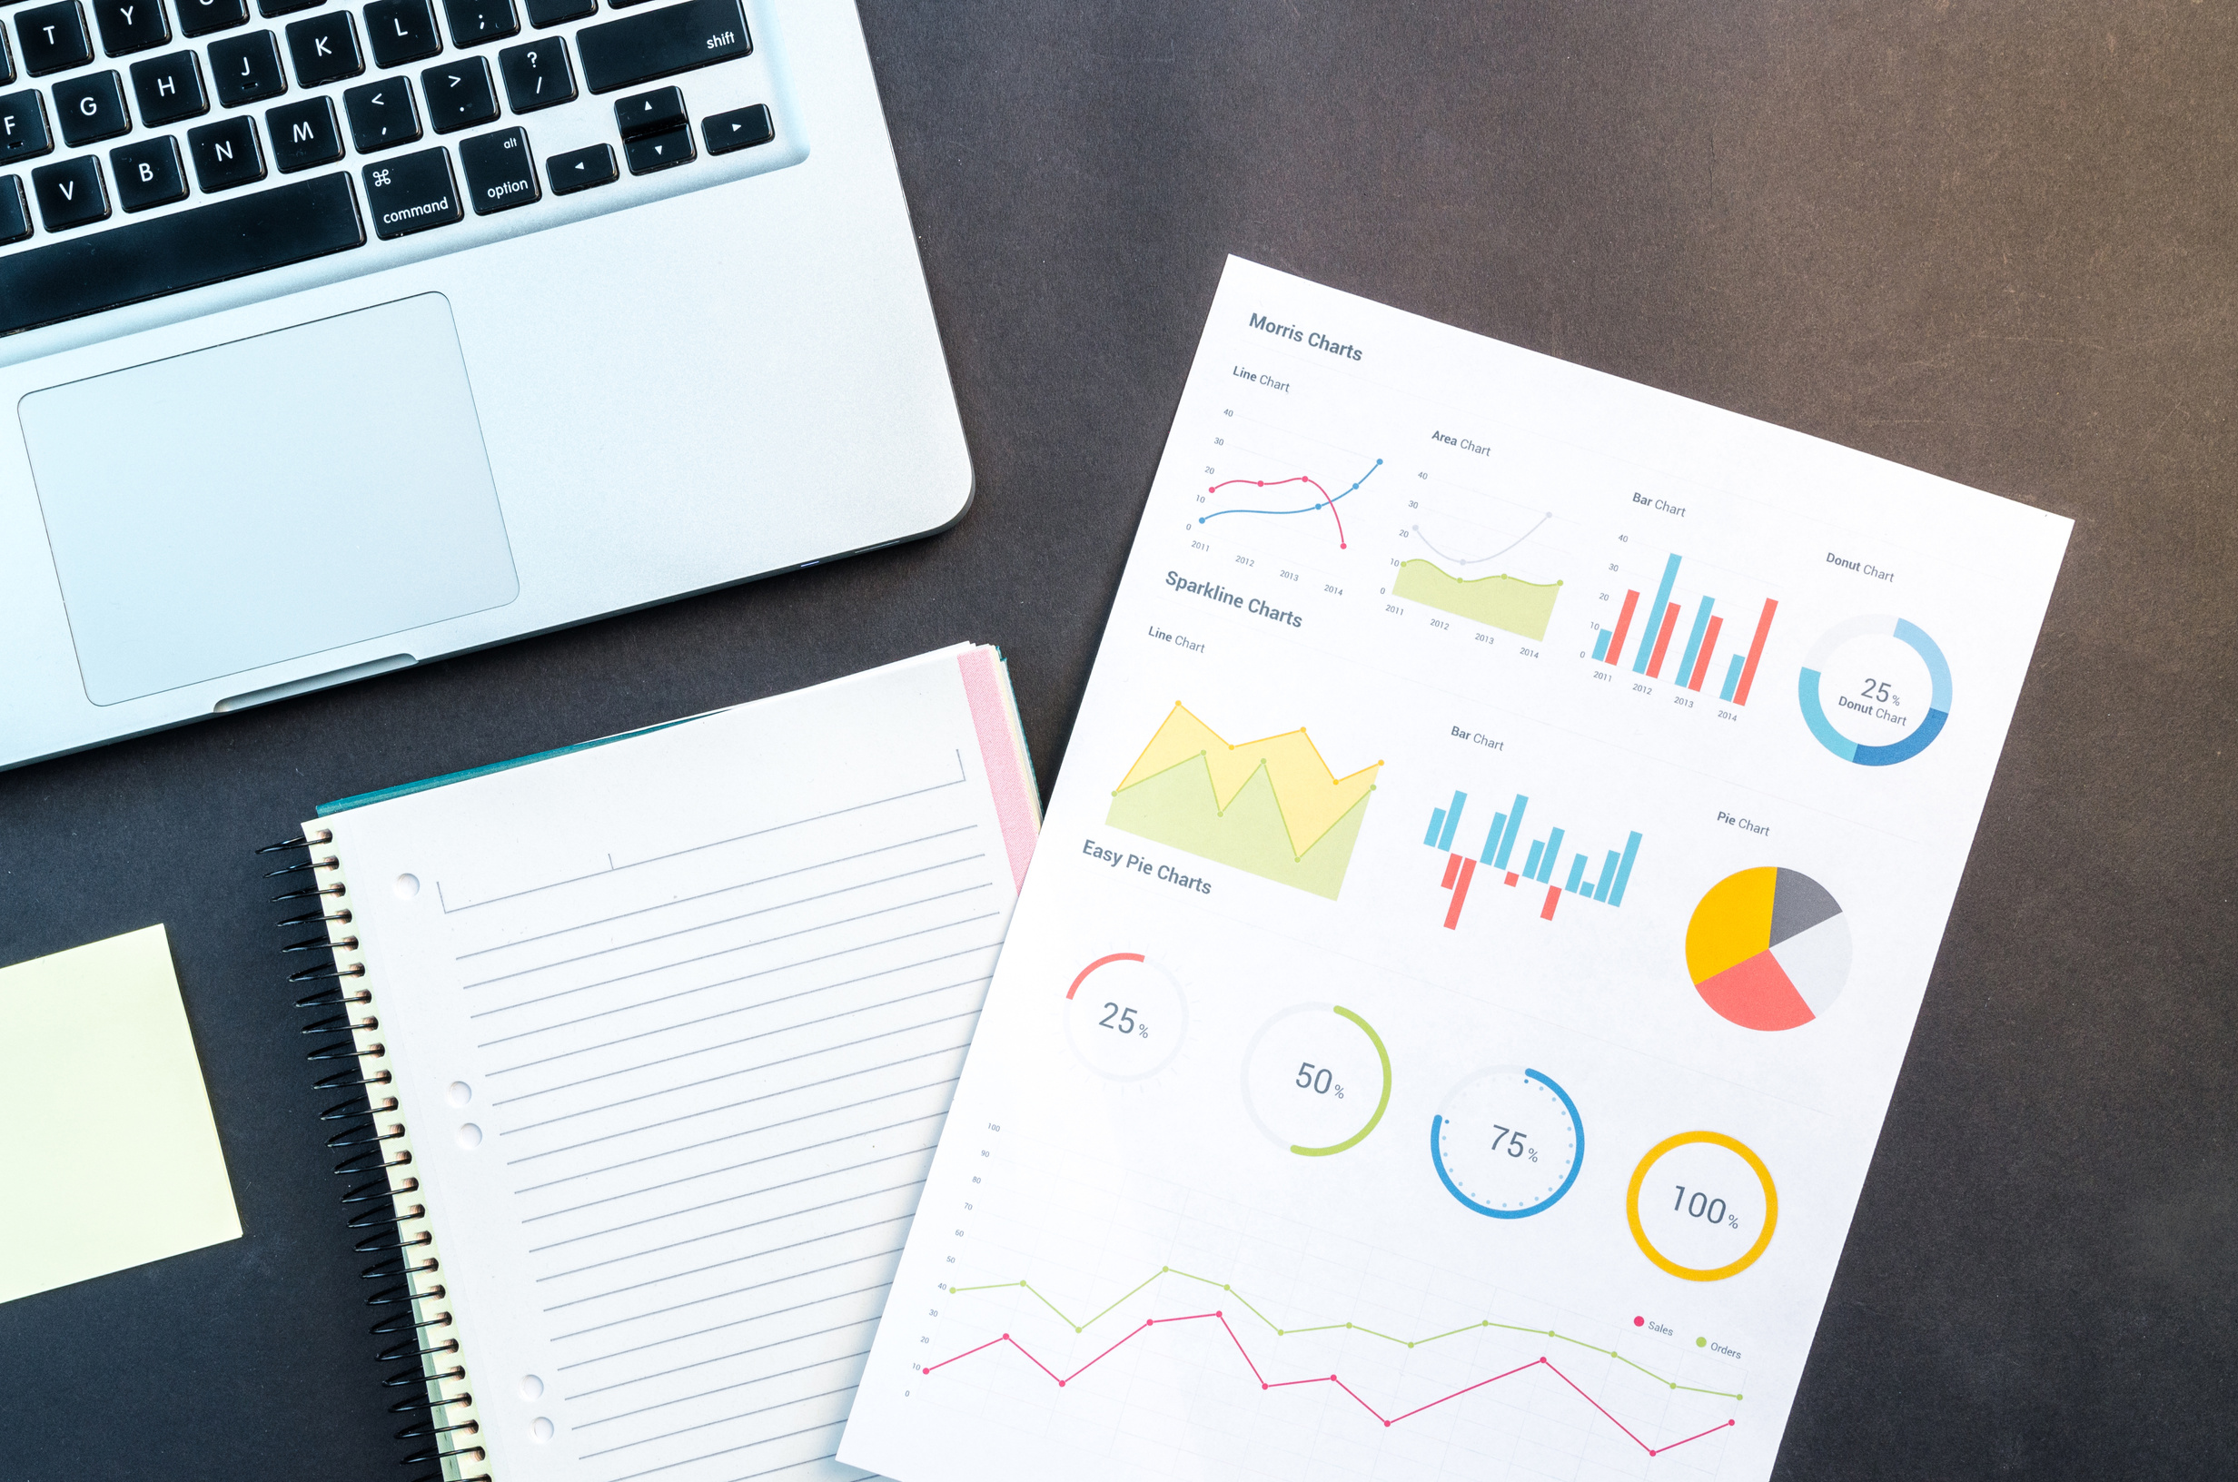
STRATEGIZE
The insides gained from the data analytics needs to be translated into actionable strategies. This involves making informed decisions that leverage the insights to achieve business goals.
The “Strategy” phase is about putting insights into action to drive business results. This involves making data-driven decisions, such as launching targeted marketing campaigns and optimising product placements and then implementing these strategies effectively.Continuous monitoring and adjustments ensure that the strategies remain effective and can be redefined to achieve the best possible outcomes. By the action on data insights, retailers can improve customer engagement, increase sale and enhance overall business performance.

Slide 10






01
NETFLIX
EXAMPLES
Plan: Netflix aims to increase user engagement and satisfaction by recommending relevant content.
Prepare: Collects data from user viewing history, ratings and interaction with platform.
Process: Standardize and integrates data across different users device and sessions.
Analyze: Applies machine learning algorithms to analyze viewing patterns and predict user preferences.
Visualization: Display personalised content recommendation on the users home screen.
Strategize: Continuously updates the recommendation algorithm based on user feedback and new data, improving content discover and user retention.

Slide 11
02
WALMART’S INVENTORY MANAGEMENT
Plan: Walmart aims to optimise inventory levels to reduce cost and improve availability.
Prepare: Collects data from POS systems, supplier transactions and market trends.
Process: Integrates data into a central system, normalise it and prepares it for predictive modelling.
Analyze: Users predictive analytics to forecast demand and identify inventory requirements.
Visualization: Provide insights through dashboards accessible to supply chain managers and store managers.
Strategize: Adjust inventory levels and automates restocking processes, leading to reduced stock outs and overstock situations.

Slide 12
THANK YOU

